Slide 2
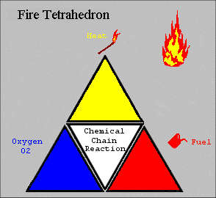
Fire Science
What elements are needed to start a fire?

Slide 3






Common Fire Classifications
“Ordinary” combustibles
Paper, wood, rubber, plastics, and textiles.
“Flammable liquids”
Oil, gasoline, solvents
“Energized circuits”
Electrical equipment
and computers

Slide 4
Class D Fires
COMBUSTIBLE
Magnesium
Sodium
Potassium
Titanium
Zirconium
other flammable metals
D
METALS

Slide 5

Class K Fires
Fires involving combustible vegetable or animal non-saturated cooking fats in commercial cooking equipment.

Slide 6
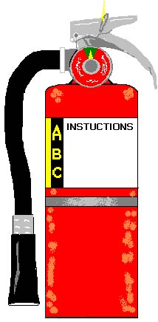
Common
Extinguisher Features
Locking pin
Carrying handle / operating lever
Pressure gauge
Label :
  Type (Water, C02, Dry Chemical)
  Classification (A, B, C)
  NFPA capacity Rating
  Instructions
Discharge nozzle or horn

Slide 7
Classification of
Extinguishers
Letters indicate class of fire for which extinguisher can be used.
Numbers indicate effectiveness of the extinguisher when used by a non-expert.
D

Slide 8
Common Types of
Fire Extinguishers
Water
Dry Chemical
CO₂
Halon
Dry Powder

Slide 9
Water
Water + CO₂ propellant
ONLY for Class fires
  wood / paper, etc.
Spreads burning liquids!
DANGER of electric shock if used on live circuits!

Slide 10
DRY CHEMICAL
Multi-Purposed Rated
Either
Or
Best for general use
Reduced risk of re-ignition
A 10 lb. unit empties in 8-10 secs.
  Effective range of 6 ft. to 15 ft.

Slide 11
Carbon Dioxide C0₂
Best on burning liquids / electrical
SHORT range - 3 to 8 ft.
10- pound unit empties in 5 to 10 seconds!
  Use short spurts!
DISPERSES QUICKLY!
  Continue applying after the fire is out!
Unit gets VERY cold - hold properly

Slide 12
Halon
Best for computers / electronics
Weight-for-weight TWICE as effective as C0₂
No residue, easy clean-up
VERY SHORT range, 3 to 6 ft.
Like C0₂, Discharges QUICKLY!
Like C0₂, Disperses QUICKLY!
  Continue after flames are extinguished

Slide 13
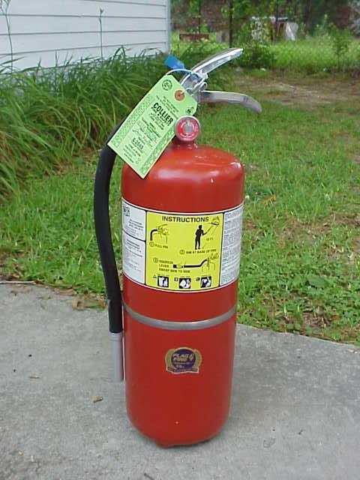
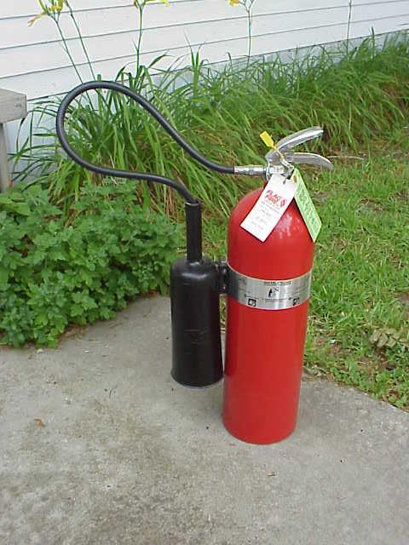
Fire Extinguishers

Slide 14
Inspection and Maintenance of Fire Extinguishers
NFPA requires extinguishers be inspected monthly, or more frequently if circumstances require it.
You must ensure that:
The extinguisher is not blocked by equipment, coats or other objects that could interfere with access in an emergency.
The pressure is at the recommended level. On extinguishers equipped with a gauge the needle should be in the green zone - not too high and not too low.
• The pin and tamper seal (if it has one) are intact.

Slide 15
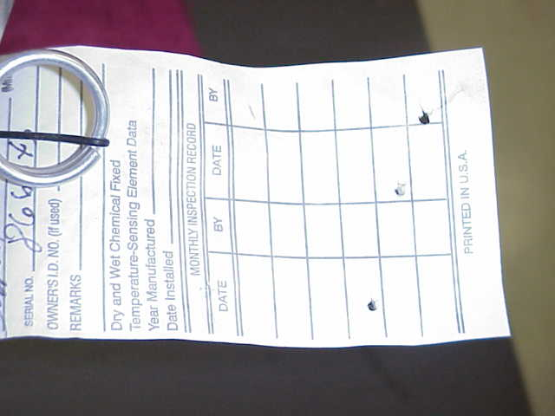
Fire Extinguisher
Inspection
INSPECTION TAG:

Slide 16
Extinguisher Maintenance
HOW OFTEN SHOULD MAINTENANCE BE PERFORMED?
The NFPA says that maintenance should be performed at least Annually!

Slide 17
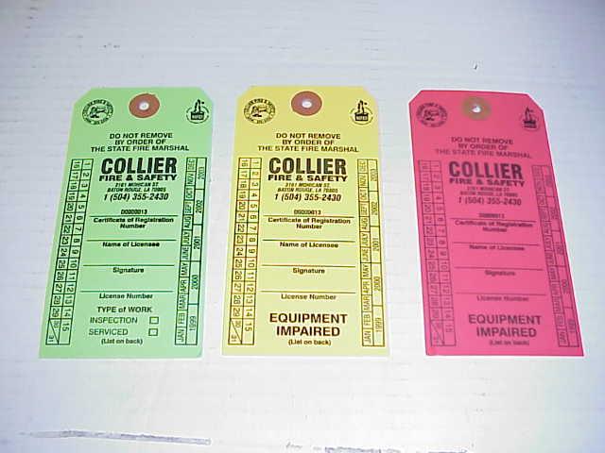
Fire Extinguishers
MAINTENANCE TAGS

Slide 18
Use a portable extinguisher
ONLY if the:
Building is being evacuated (Fire alarm has been pulled)
Fire Department has been called (Dial 911!)
Fire is NOT spreading (small and contained)
EXIT IS CLEAR (fight fire with your back to an exit )
Proper extinguisher is at hand, and...
  You have been trained and know how to use it!
  You use “Buddy System” - have someone back you up!
    Get assistance BEFORE trying to fight a fire!

Slide 19
PASS
Pull the pin
Aim low at the
base of flames
Squeeze the
handle
Sweep side to side

Slide 20
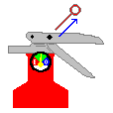
PULL the pin

Slide 21
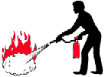
AIM
LOW at the base of the fire

Slide 22
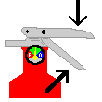
SQUEEZE
the lever

Slide 23
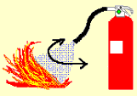
SWEEP
from side to side

Slide 24

OK, It’s out…
Now What?
WATCH the fire area
  If the fire flares up again repeat!
  If you can’t control the fire, LEAVE immediately!
Call the fire department to inspect the scene!
Recharge or replace any used fire extinguisher!

Slide 25

Questions?

